Slide 1

Unreal Engine
5
The Complete Beginner’s Course

Slide 2
Problems with existing courses
Unstructured
No details

Slide 3
Advantages of this course
Structured
Detailed

Slide 4
Unreal Engine
5
The Complete Beginner’s Course

Slide 5
Unreal Engine History

Slide 6
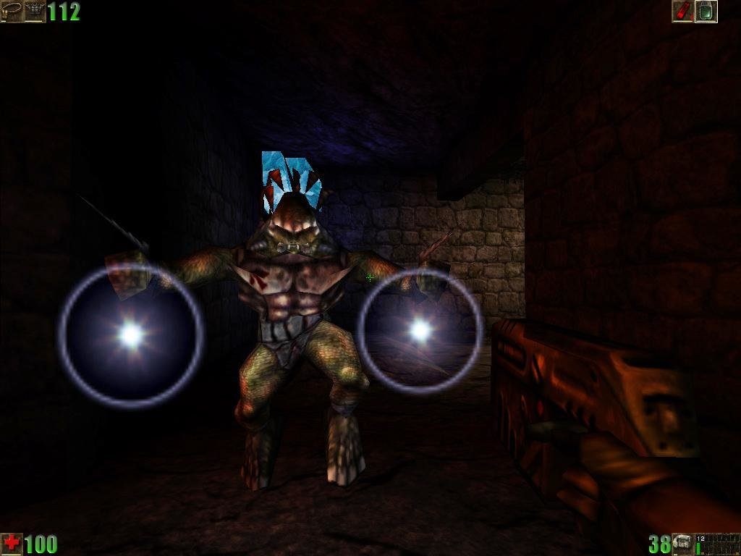
Unreal (1998)

Slide 7

Unreal Tournament

Slide 8
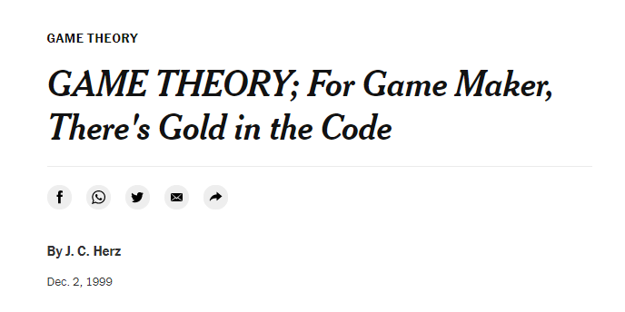
Licensing

Slide 9
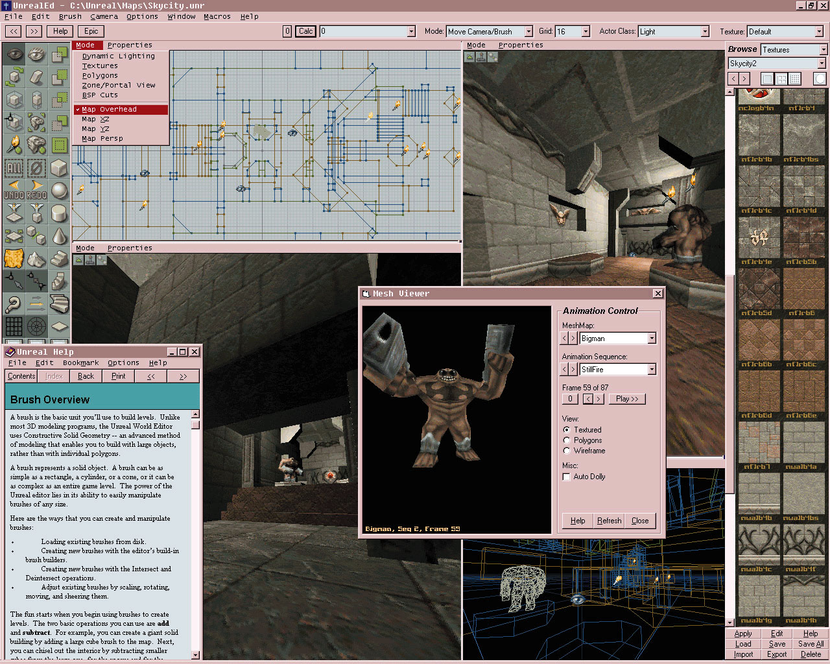
Unreal Engine

Slide 10
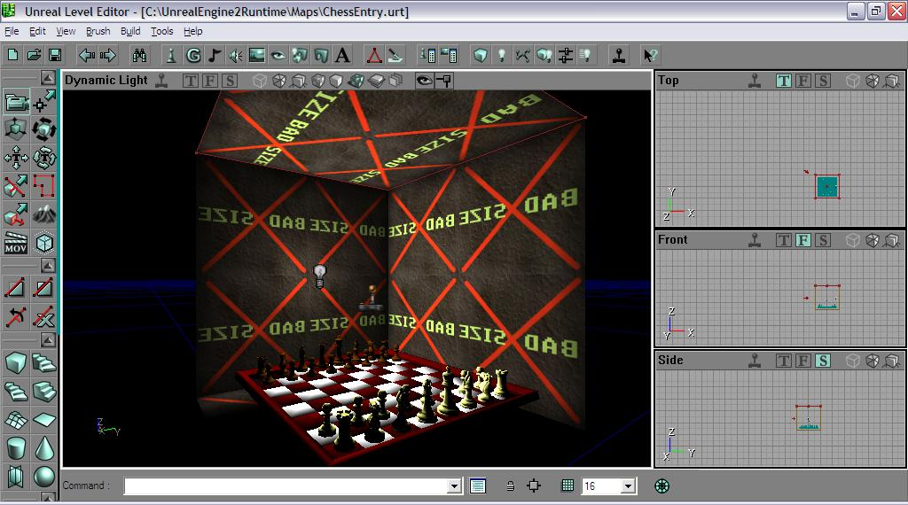
Unreal Engine 2

Slide 11
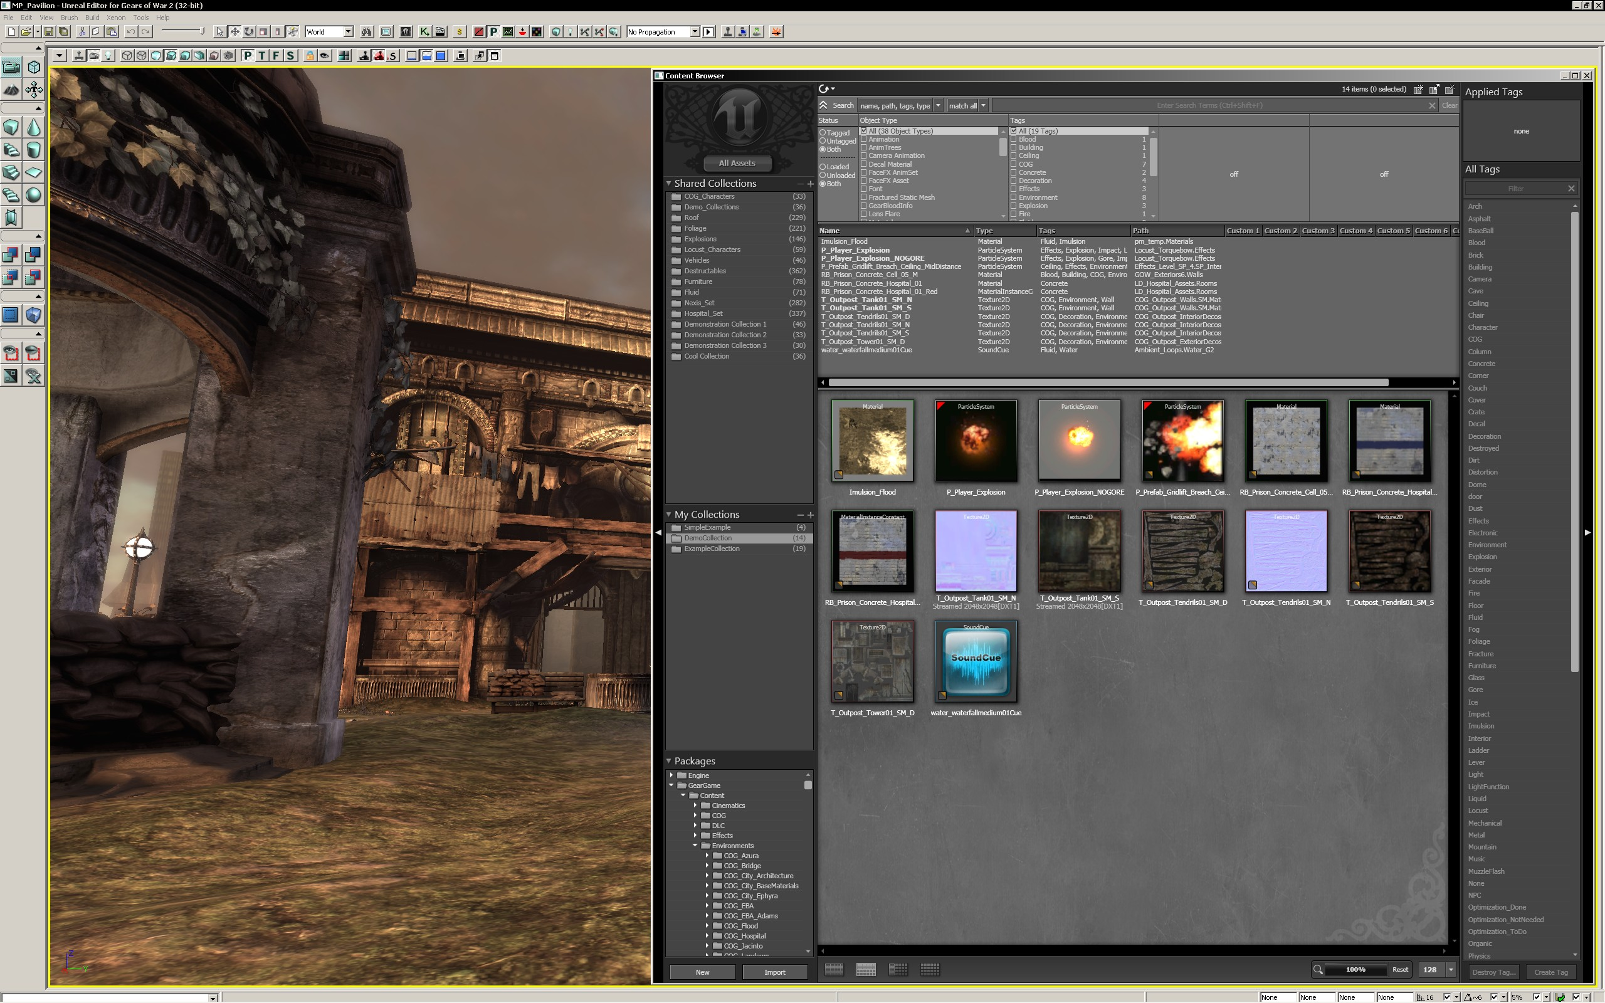
Unreal Engine 3

Slide 12
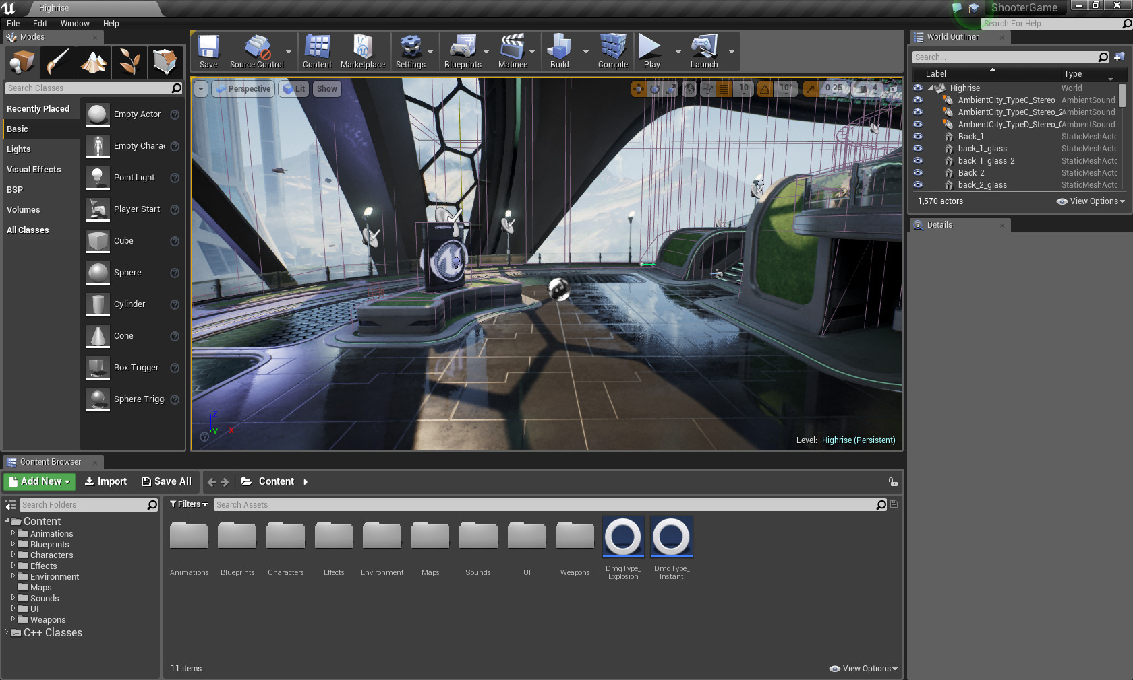
Unreal Engine 4

Slide 13
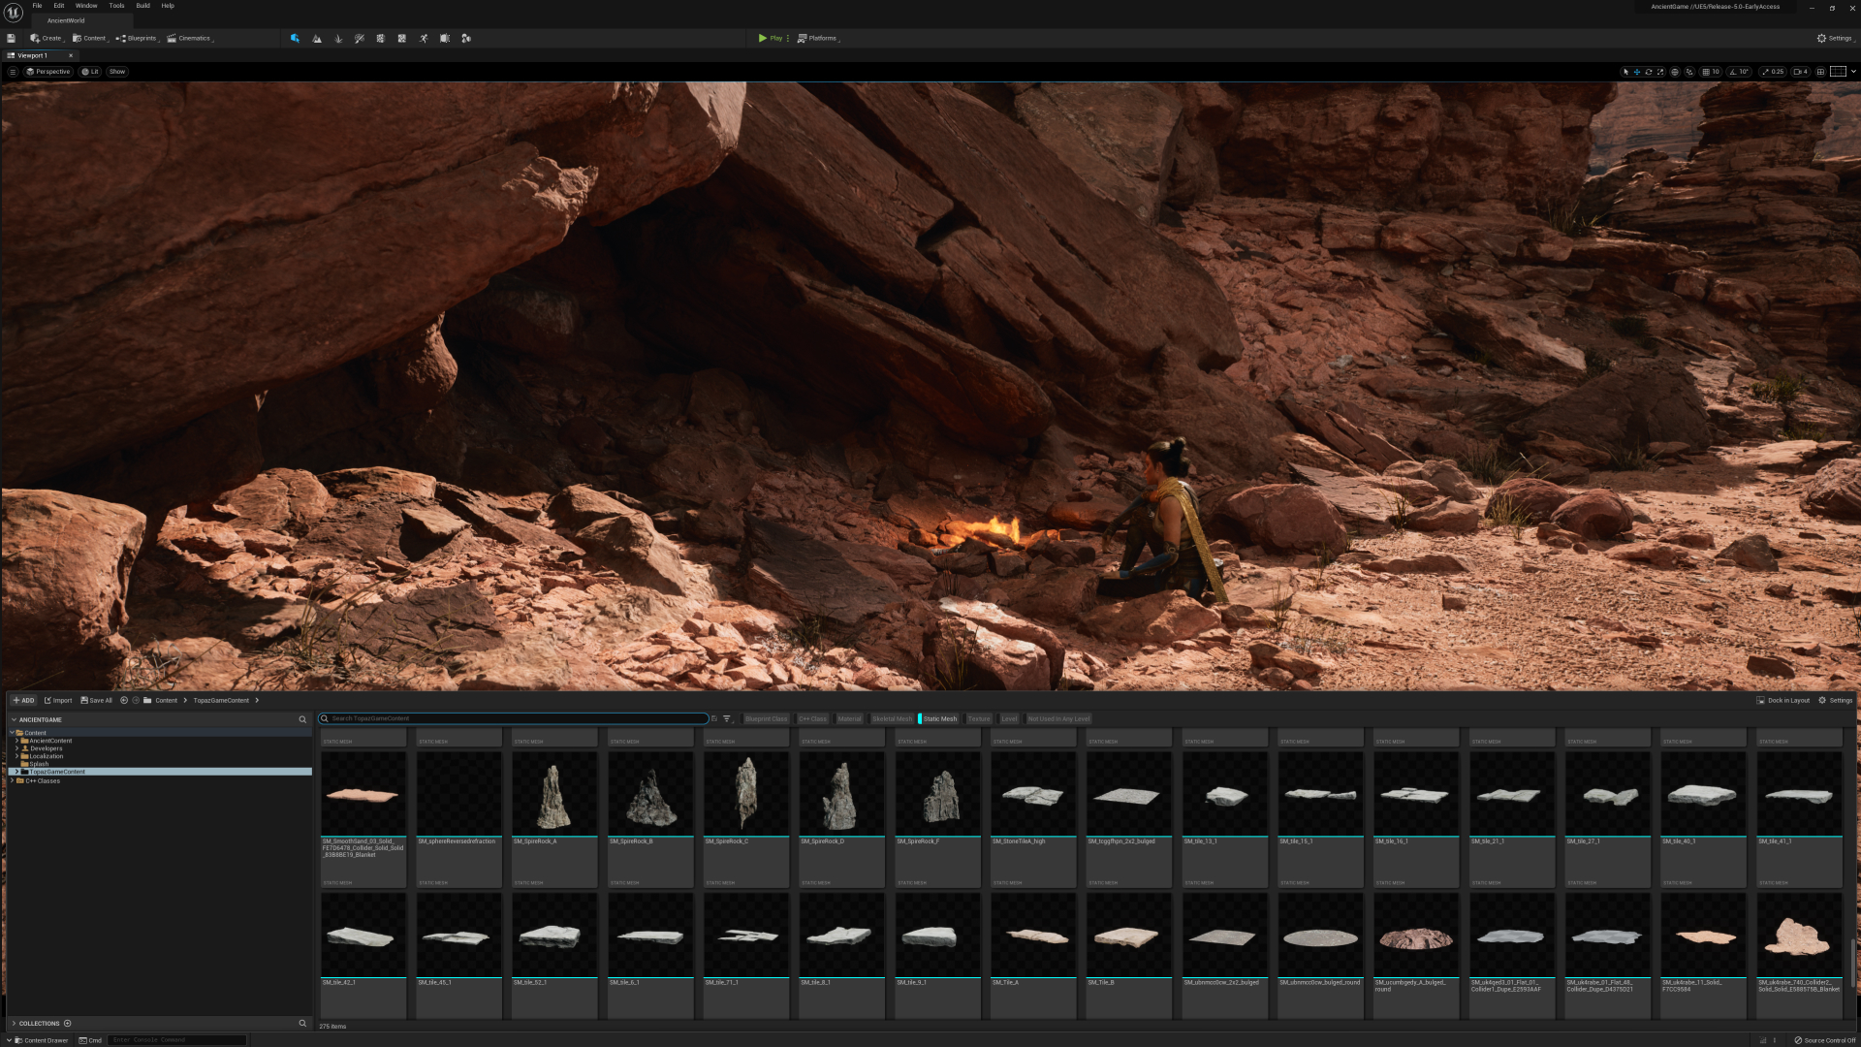
Unreal Engine 5

Slide 14
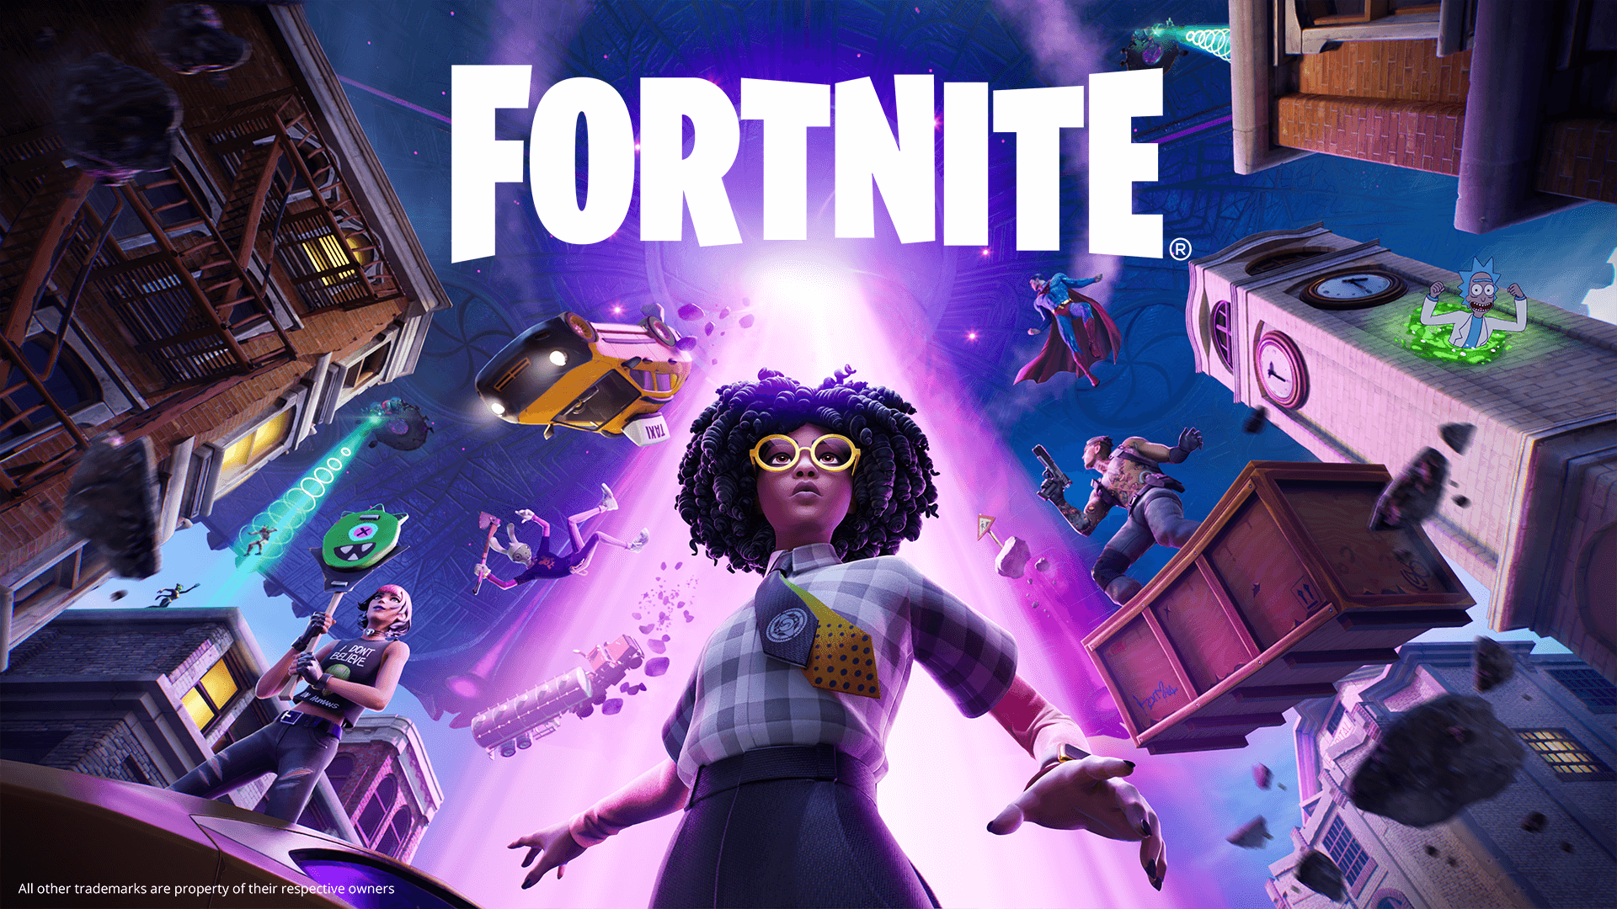

Slide 15


Slide 16


Slide 17


Slide 18


Slide 19


Slide 20


Slide 21


Slide 22


Slide 23
Unreal License Agreement
pre-2015 - expensive fee
2015-2020 - 5% royalty on sales > $3000
2020-present - 5% royalty on sales > $1 million

Slide 24
Course Sections

Slide 25
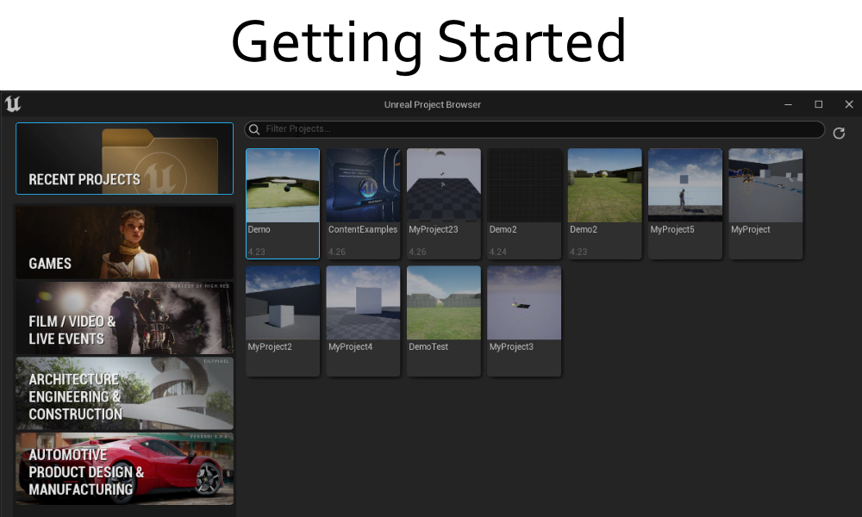
Course Sections
Getting Started

Slide 26
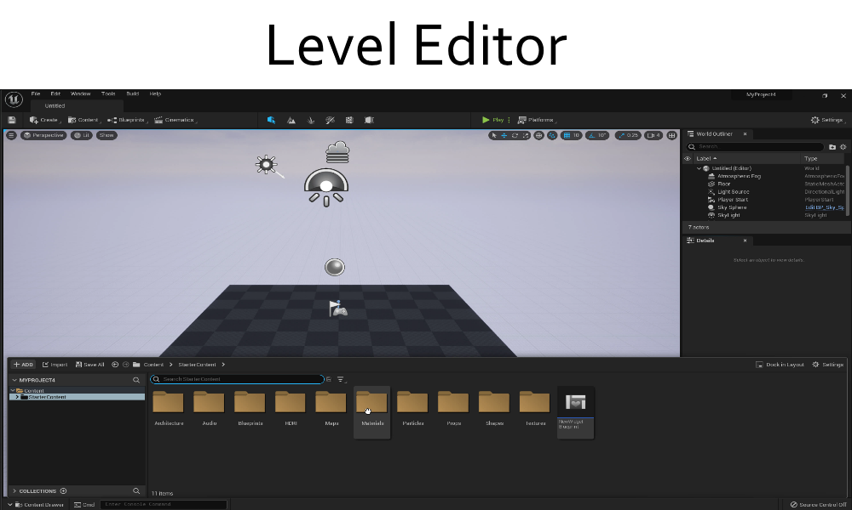
Course Sections
Getting Started
Level Editor

Slide 27
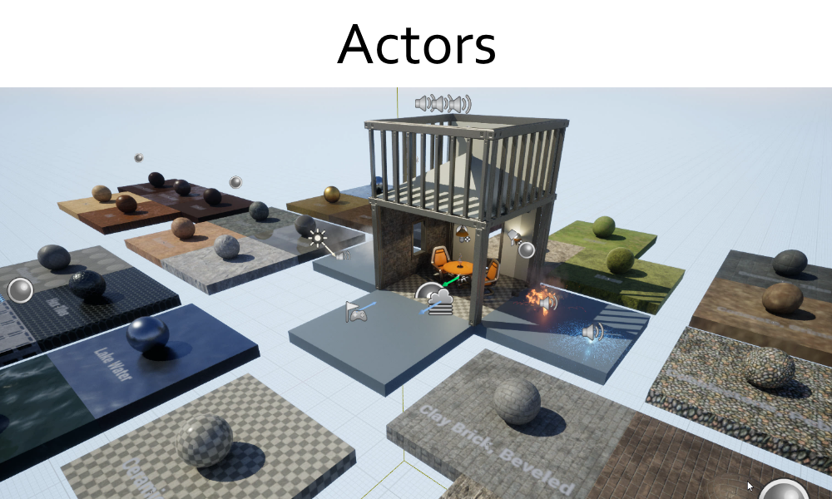
Course Sections
Getting Started
Level Editor
Actors

Slide 28
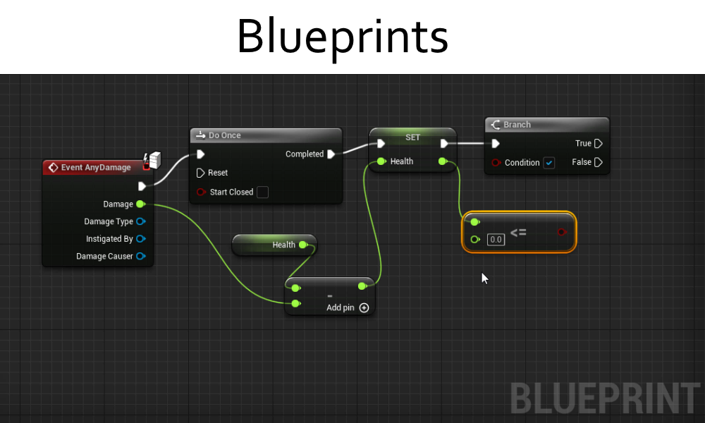
Course Sections
Getting Started
Level Editor
Actors
Blueprints

Slide 29
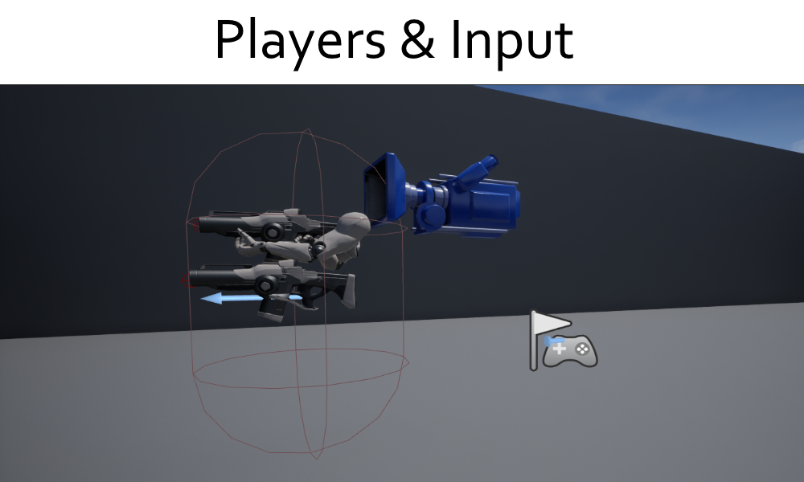
Course Sections
Getting Started
Level Editor
Actors
Blueprints
Players & Input

Slide 30
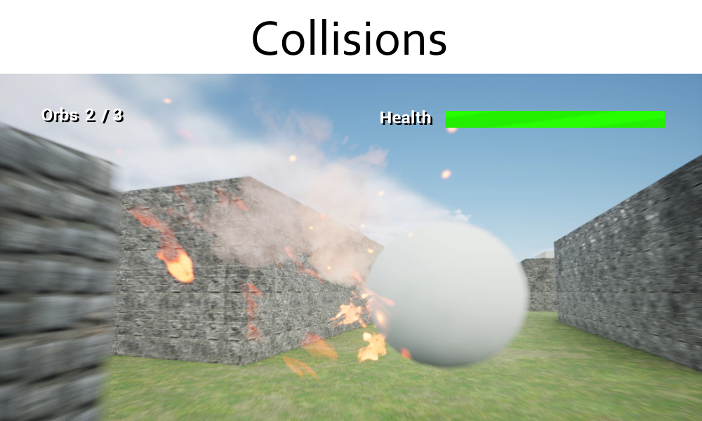
Course Sections
Getting Started
Level Editor
Actors
Blueprints
Players & Input
Collisions

Slide 31
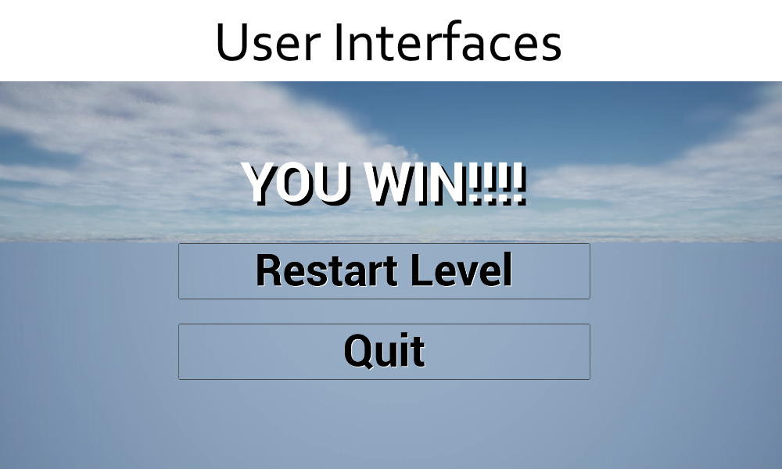
Course Sections
Getting Started
Level Editor
Actors
Blueprints
Players & Input
Collisions
User Interfaces

Slide 32
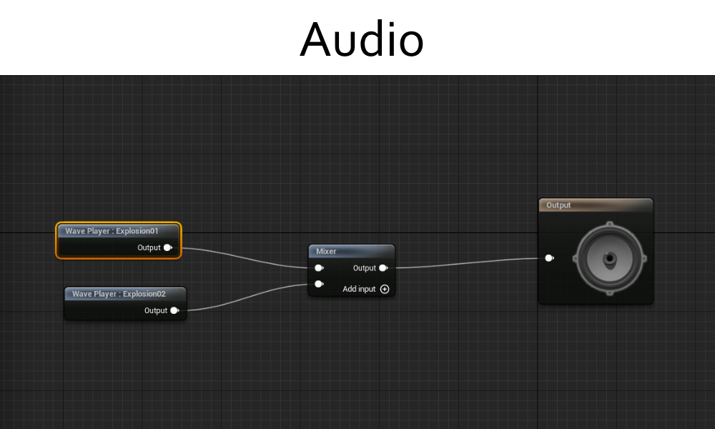
Course Sections
Getting Started
Level Editor
Actors
Blueprints
Players & Input
Collisions
User Interfaces
Audio

Slide 33

Course Sections
Getting Started
Level Editor
Actors
Blueprints
Players & Input
Collisions
User Interfaces
Audio
Additional Topics

